Slide 1
Nyquist Plot – First Order Lag

Slide 2
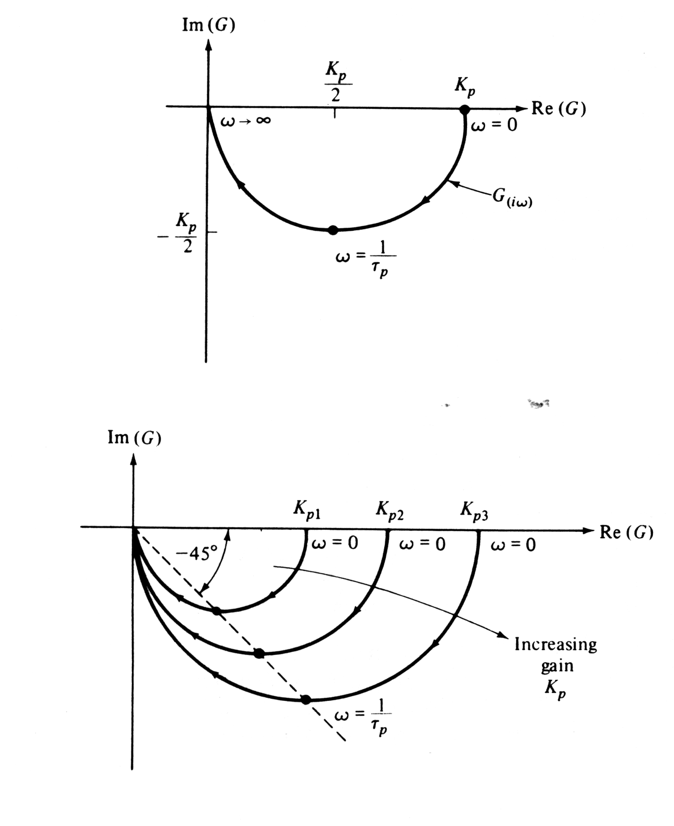

Slide 3
Nyquist Plot – First Order Lead

Slide 4
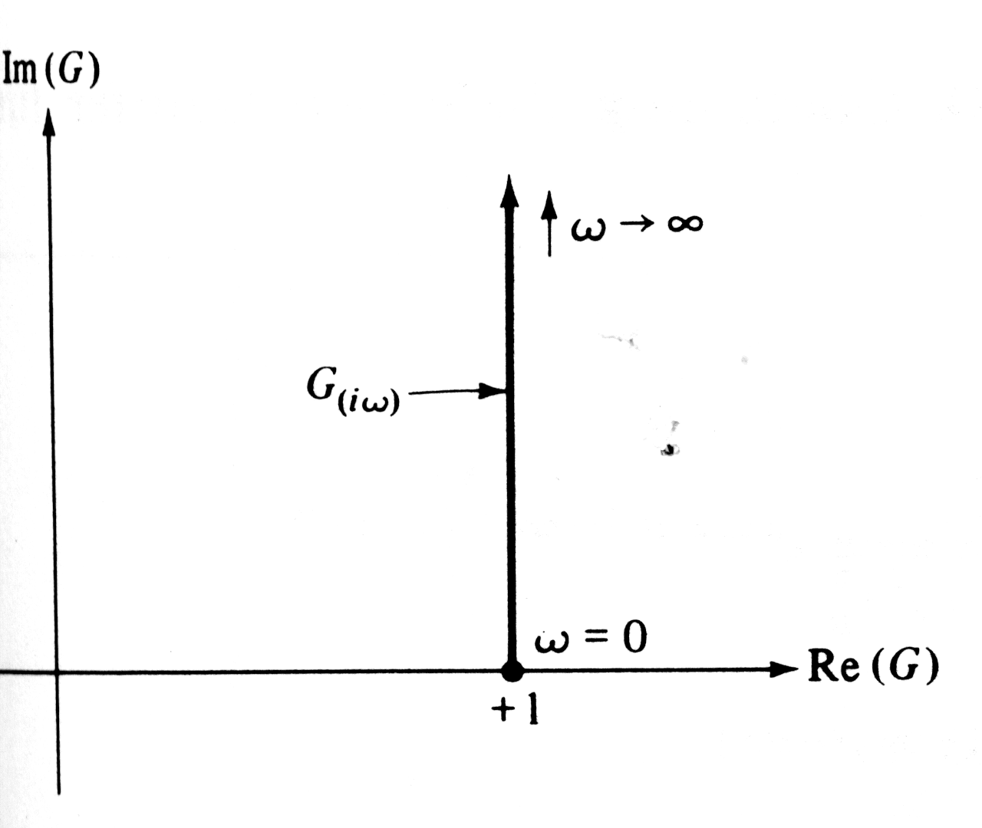

Slide 5
Nyquist Plot – Time Delay

Slide 6
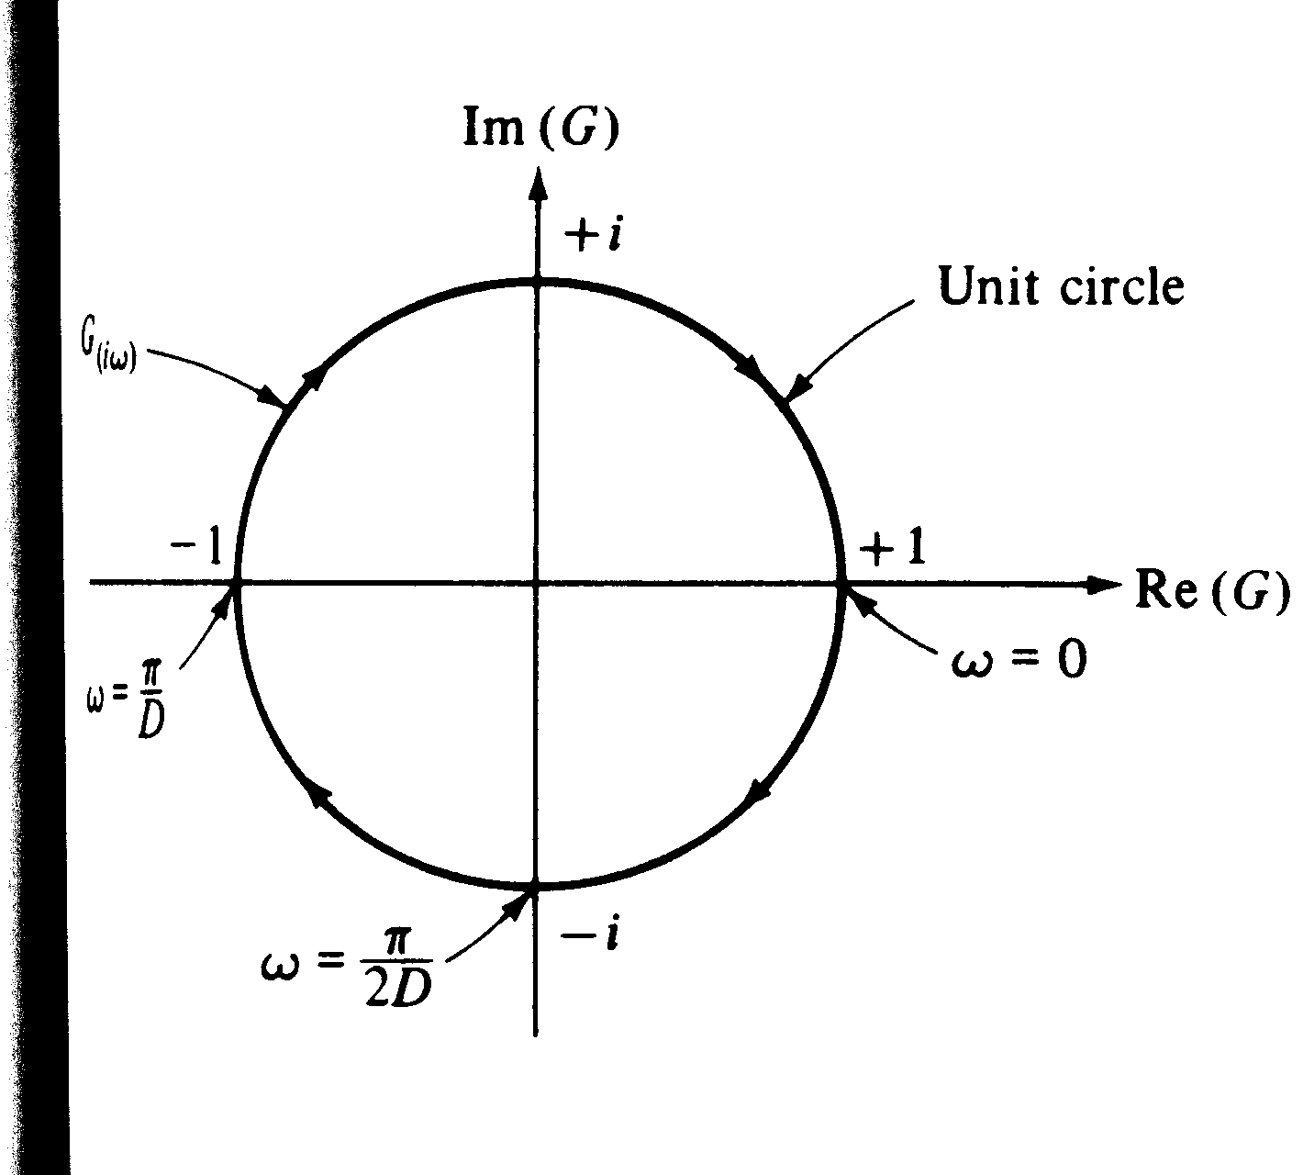

Slide 7
Nyquist Plot – FOPDT

Slide 8
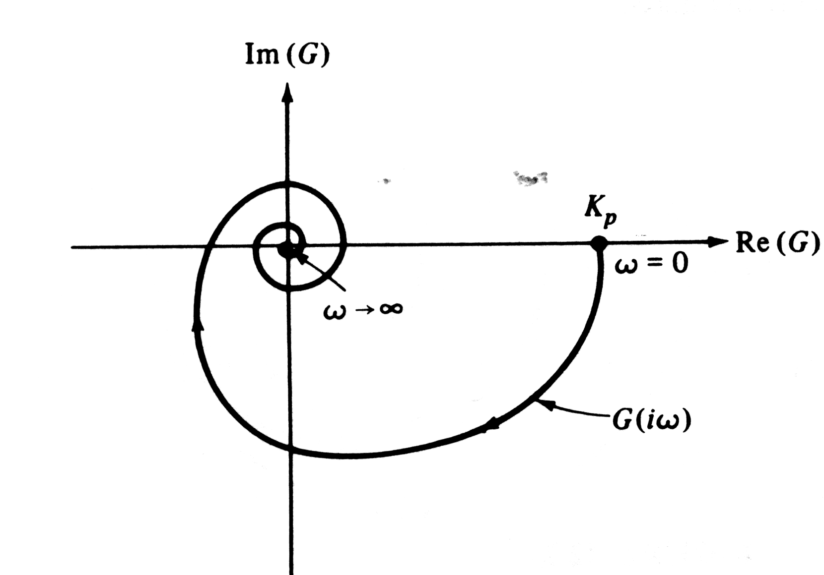

Slide 9
Nyquist Plot – Integrator

Slide 10
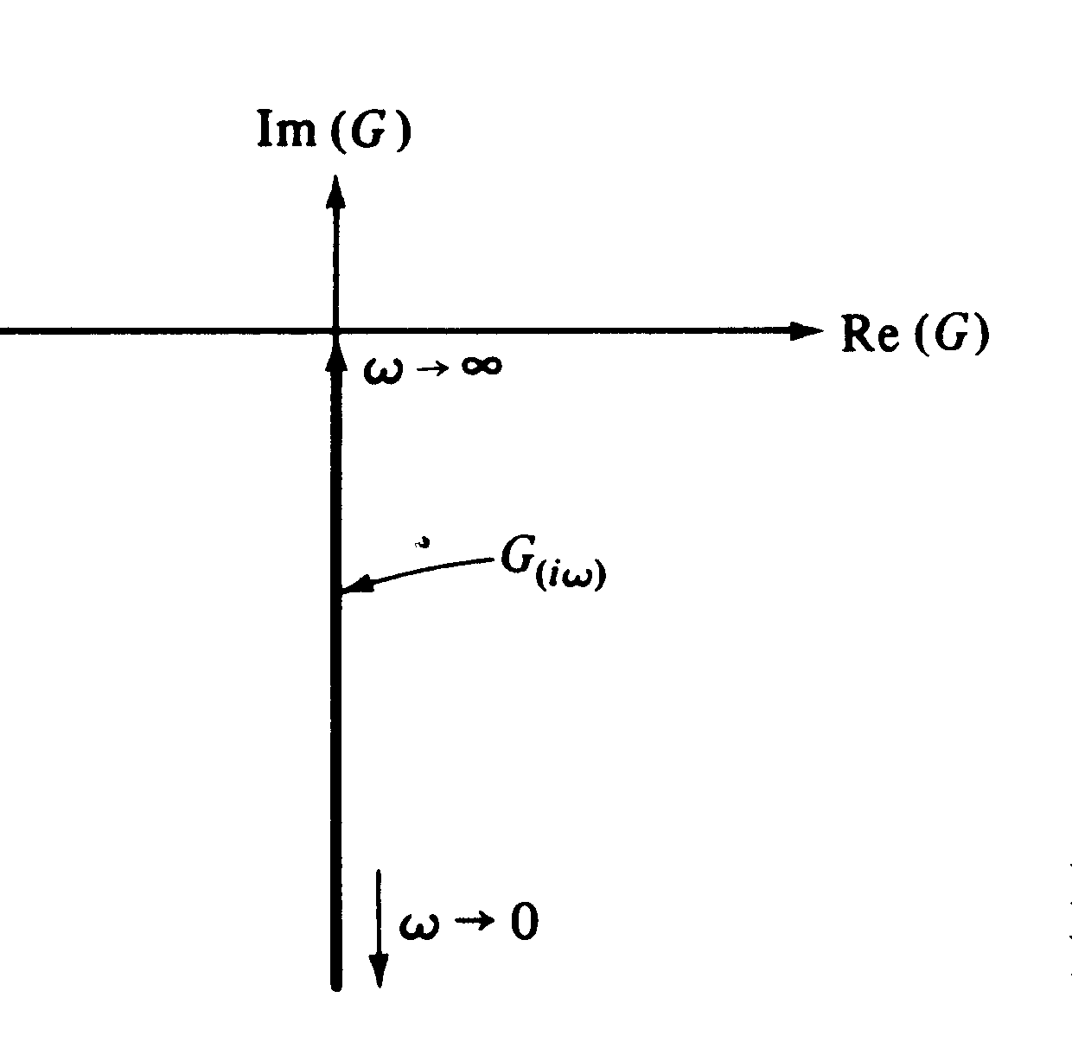

Slide 11
Nyquist Plot – Integrator and 1st Order Lag

Slide 12
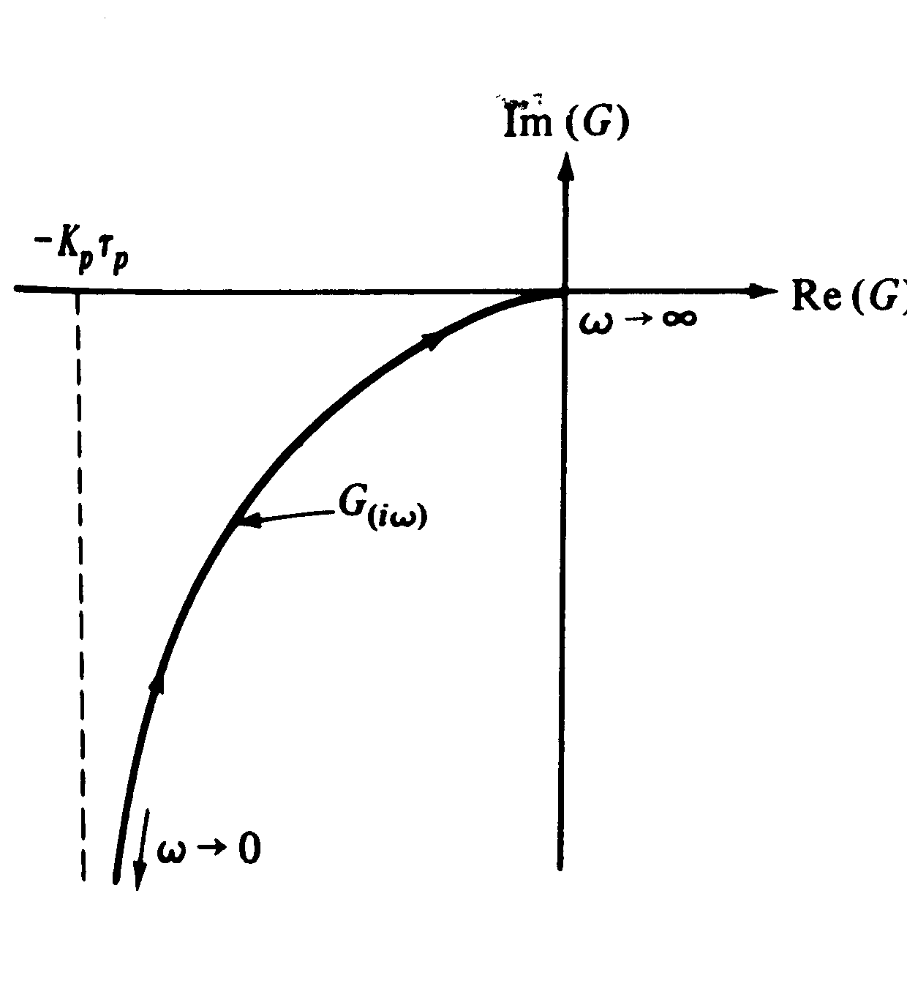

Slide 13
Nyquist Plot – 2nd Order Underdamped System

Slide 14
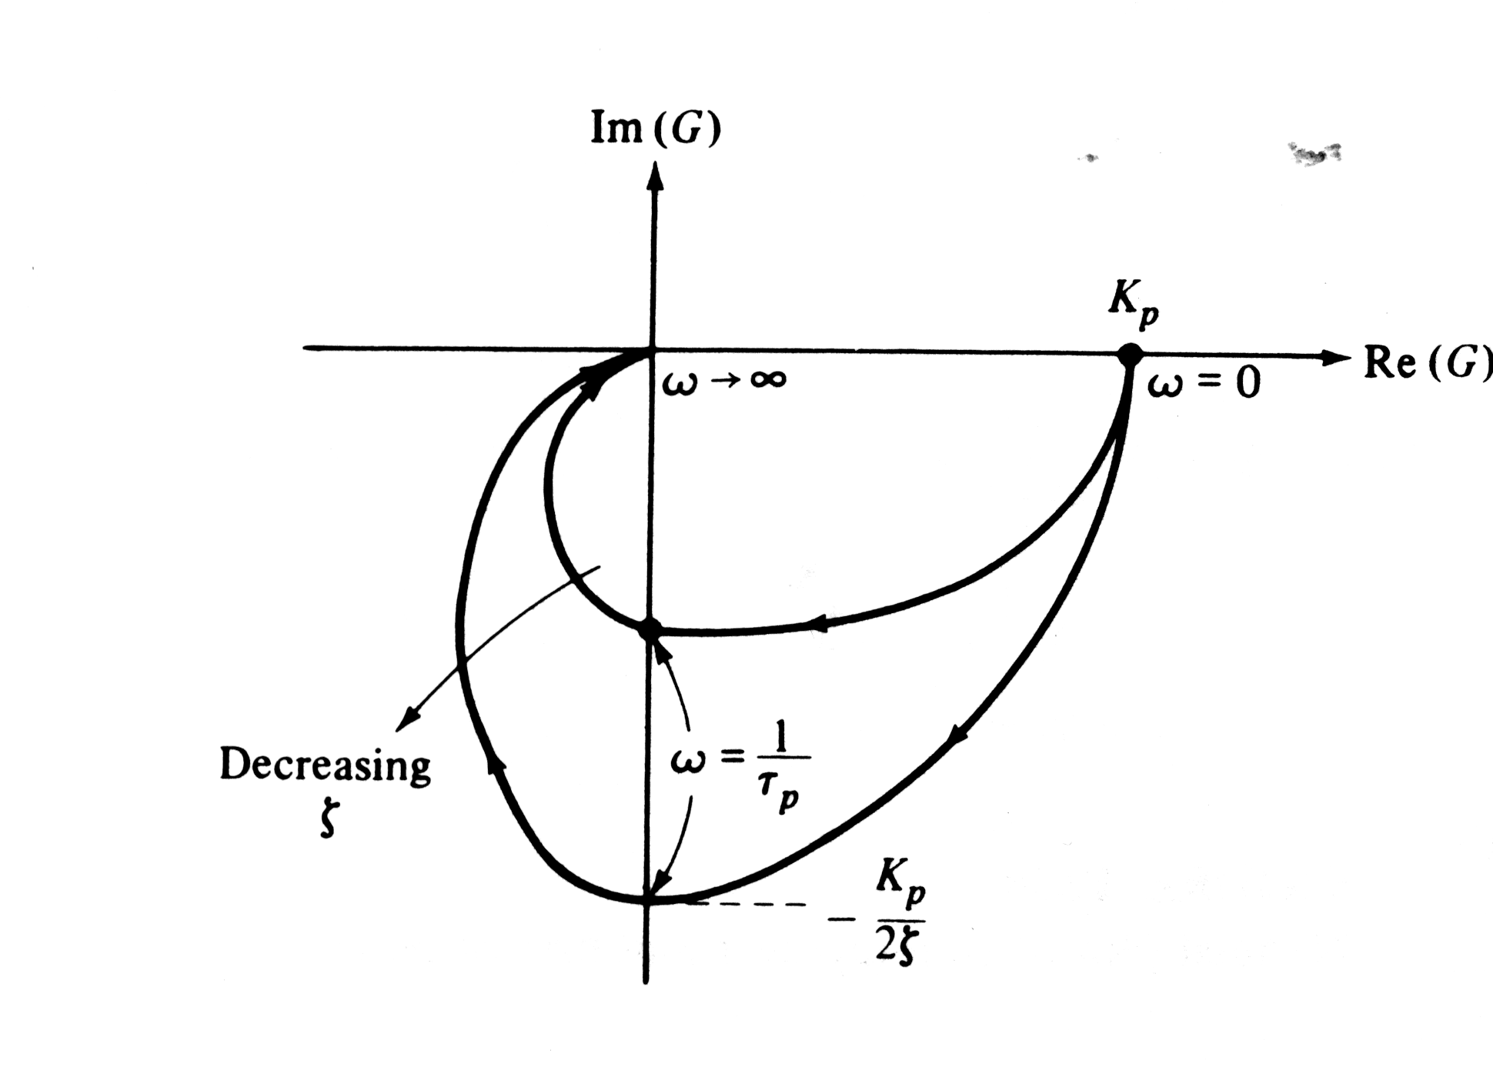

Slide 15
Nyquist Diagrams
Consider the transfer function
with
and

Slide 16
Figure 13.12 The Nyquist diagram for G(s) = 1/(2s + 1) plotting and

Slide 17
Figure 13.13 The Nyquist diagram for the transfer function in Example 13.5:

Slide 18
Frequency Response Characteristics of Feedback Controllers
Proportional Controller. Consider a proportional controller with positive gain
In this case , which is independent of ω. Therefore,
and

Slide 19
Proportional-Integral Controller. A proportional-integral (PI) controller has the transfer function (cf. Eq. 8-9),
Substitute s=jω:
Thus, the amplitude ratio and phase angle are:

Slide 20
Figure 13.9 Bode plot of a PI controller,

Slide 21
Ideal Proportional-Derivative Controller. For the ideal proportional-derivative (PD) controller (cf. Eq. 8-11)
The frequency response characteristics are similar to those of a LHP zero:
Proportional-Derivative Controller with Filter. The PD controller is most often realized by the transfer function

Slide 22
Figure 13.10 Bode plots of an ideal PD controller and a PD controller with derivative filter.
Idea:
With Derivative Filter:

Slide 23
PID Controller Forms
Parallel PID Controller. The simplest form in Ch. 8 is
Series PID Controller. The simplest version of the series PID controller is
Series PID Controller with a Derivative Filter.

Slide 24
Figure 13.11 Bode plots of ideal parallel PID controller and series PID controller with derivative filter (α = 1).
Idea parallel:
Series with Derivative Filter:

